Slide 1
SOLVING AN OPTIMAL LOCATION PROBLEM – To venture into a restaurant business
RAM SUBRAMANIYAN

Slide 2

In this project we will be determining the optimal location of a business in the London city and Greater London area -

Slide 3
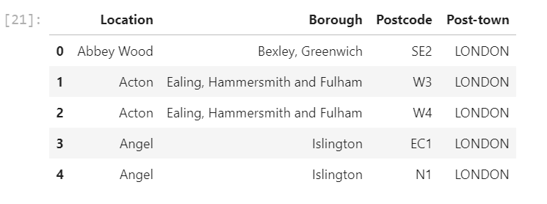
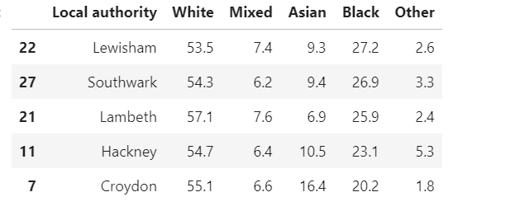
Post several assumptions and that only the 'Location', 'Borough', 'Postcode', 'Post-town' will be used for our data analysis. Data is transformed in following views based on location and demographic data.

Slide 4
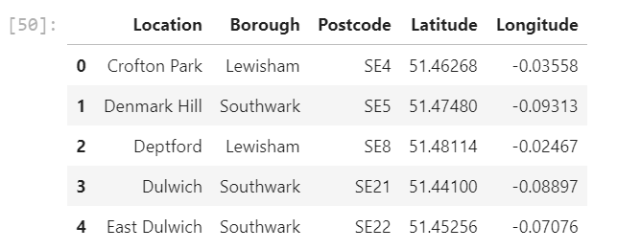
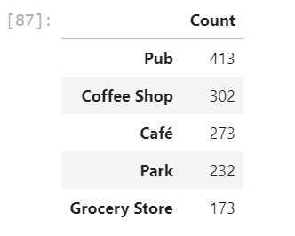
Using feature engineering and exploratory data analysis, Perform data analysis for single and multiple neighborhoods;
Using Four square API data, prepare URL to do API call and obtain data to explore venues of the above said boroughs.
All required Neighborhood, Venues Latitude and Longitude along with Venue category was extracted

Slide 5
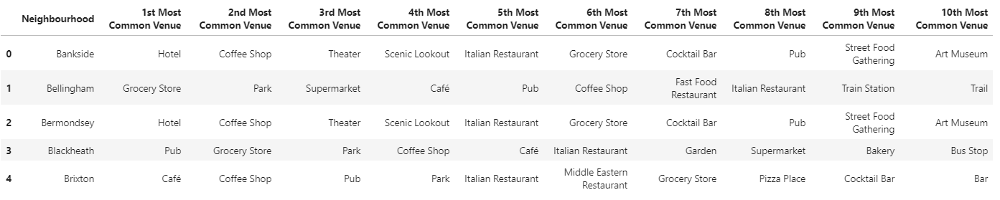
One-hot Encoding
This technique was used to explore the Venue Categories for given neighborhoods. This way, most common venues were determined.

Slide 6
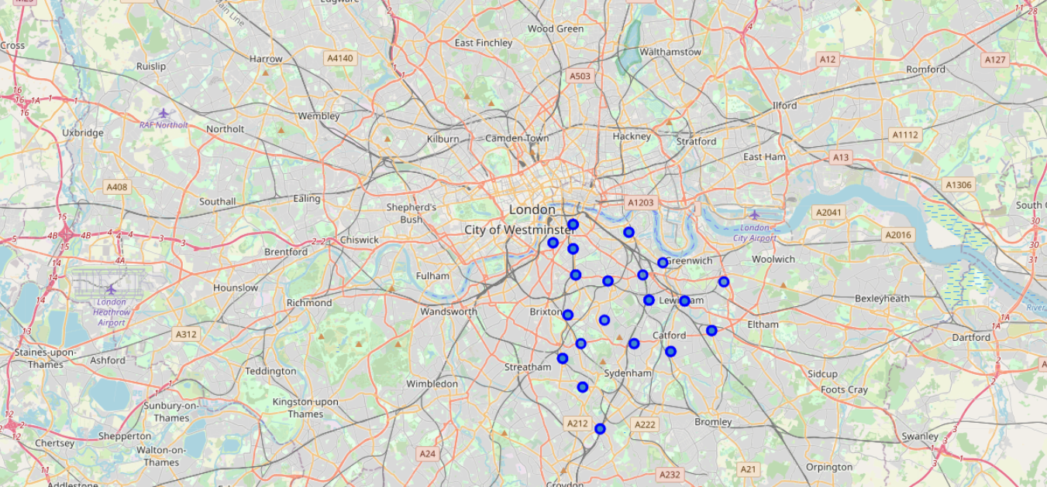
Using Visualization, neighborhoods in South East London will be marked based on the processed data obtained above.

Slide 7
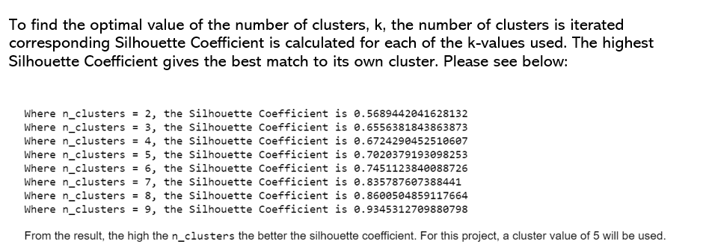
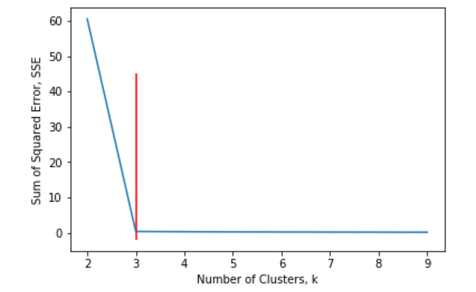
Clustering of Neighborhoods
K-Means clustering technique is used in the project to accomplish goal.
Generate and checking Cluster labels is necessary to identify what area belongs to which cluster label.
Using Elbow method and Silhouette Coefficient, no. of clusters to be used for k-means clustering model is determined.
In this case, 5 Clusters was the optimum.

Slide 8
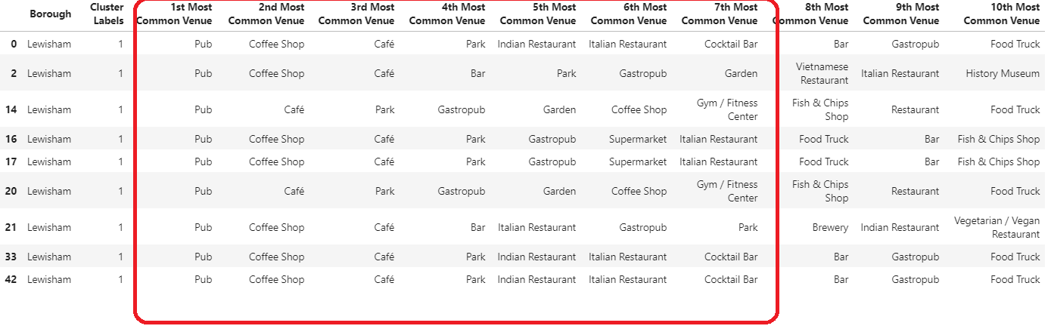
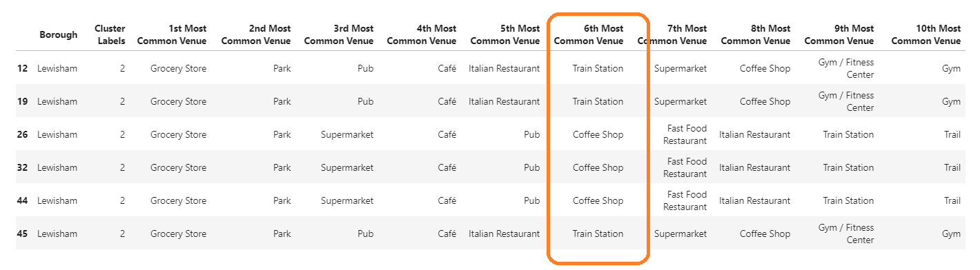
Of the 5 cluster’s data analyzed, using cluster labels assigned in previous steps, it is determined that cluster 2 (cluster label 1) and 3 (cluster label 2) are more suitable in terms of many aspects that reinforces opening a new restaurant / food joint.

Slide 9
Conclusion
We can conclude with the results above that Cluster 2 and Cluster 3 are the most viable clusters to create a brand multi-cuisine Restaurant. Their proximity to other amenities and accessibility to Train station should be noticed.
These 2 clusters do not have top restaurants that could rival their standards if they are created.
Hence, the most suitable location in Greater London city would be ‘Lewisham’ neighborhood in South East London!!

Slide 10
Thank You!

